Slide 1




Xduplify TOKEN (X)
t.me/Xduplify
www.xduplify.com
twitter.com/xduplify

Slide 2

Revolutionizing the way to Take Less Risk
The world is changing and so is the cryptocurrency market. Get acquainted with the new idea of investments in the world of cryptocurrencies and get closer to achieving your goals..

Slide 3

Growth Roadmap
Public Sale
Dual investment Website Launch
Dividend Tracker Dashboard
Dual investment System launched
XDuplify Lottery system
Coin gecko listing
Coinmarketcap listing
Q3/23
Q2/23
Project team kick off meeting
Design and Structure
ICO website developed
XDuplify Token developed
Marketing campaign
Presale (Private & Public)
Smart Contract Audit
Q1/24
Xduplify Investment Bot
Xduplify Liquidity Locker (Dual investment/rewards)
XDuplify wallet
XDuplify Swap

Slide 4

Intro Video Xduplify

Slide 5
Xduplify Profit Share – Dual Investment

Slide 6


What we do
Options up to 5x your liquidity
Great Financial Model
XDuplify Lottery
A plan based on the duality of short-term and long-term, so as to comprehensively meet the expectations of users. Also a favorable plan for crypto providers.
A financial model based on low risk and high chance of high return. Flexible liquidity deposits for liquidity providers with high earning return (No lock-in term - withdraw anytime).
A lottery that rewards in BUSD instead of the native token to keep the chart in top condition.

Slide 7
Great Financial Model
Fees Distribution
Below is the distribution of fees collected by Xduplify.
Token X buy/sell % Distribution (If any tax is charged).
2% to Dual investment Locker
2% to Marketing
0.5% to Lottery
0.5% to Liquidity
Dual investment Establishment fee % + Profit share 50%.
100% of fees accumulated split.
20% to Business (Growth, wages, development)
20% marketing
20% Dual investment locker
10% to X locker (Busd rewards for tokens locked)
20% Lottery
10% Buy/Burn Native token
Dual investment Establishment fee % + Profit share 50%.
100% Liquidity Provider (Busd rewards for liquidity providers for dual investment)

Slide 8
Xduplify Lottery
XDuplify Lottery
The lottery has been established for users and X token benefits.
All Lottery payments are made in BUSD and not native tokens.
All ticket for the lottery is purchased using the native token X and burnt.
The lottery run time is the 1st Saturday of every Month.
40% of the total amount in the lottery pool available will be distributed to the winners.
60% is reinvested in the next monthly round.
Distribution of winnings %
1st 50%
2nd 30%
3rd 10%
4th 5%
5th 3%
6th 2%

Slide 9

Xduplify Dual Investment Trading
The dual Investment works with Xduplify and the trader in investing in the listed coins decided by the trader.
Example: Trader wishes to buy Bitcoin.
Initial Deposit of trader to purchase bitcoin $1,000 BUSD.
Trader wishes to 5x the investment with Xduplify
A total of $6,000 BUSD of bitcoin will be purchased and locked until consolidation.
The dual investment will not go through if the capital is unavailable for trading.
The amount available for trading can be found on the initial dual investment DAPP.

Slide 10
Xduplify Dual Investment Trading Locked
The dual investment tokens are locked until the trader decides to consolidate the dual investment.
Once consolidated the profit share will be automatically calculated and collected by Xduplify.
The remaining balance becomes available for collection by the trader.

Slide 11
Xduplify Dual Investment Trading Term
There is no Locked contract term that the dual investment must stay active for, the trader can decide when to consolidate the dual investment.
The dual investment can only continue for a max of 6 months at which point the dual investment will auto consolidate and begin the process of profit share and unlock the tokens for collection.

Slide 12
Xduplify has implemented an Auto Consolidation for the following circumstances below for protection.
Length of investment has hit 6 months
If the initial trader amount value decreases by 70% value.
At this point, the contract will auto-consolidate. The initial investment made by Xduplify will be returned and the remaining amount will be available for the user to collect.
.
RISK MITIGATED

Slide 13
Xduplify Profit Share
The profit share of the dual investment is calculated based on the following process.
The length of term the dual investment has been active for determines the % of shares to Xduplify.
Starting at 2% and increasing by 2% per week to Xduplify in profit share.
Max profit share to Xduplify for 6 months is 48%.
Max profit share to Trader for 6 months is 52%.

Slide 14
Xduplify Profit Share
Profit share is only calculated if profits are made above the initial investment amounts of the trader and Xduplify.
For example, if the trader decides to auto-consolidate without any profits being made, the initial investment amounts will be returned to Xduplify and the remaining amount will be available for unlock for the user.
There are no additional fees payable due to no profits being made.

Slide 15
Xduplify USE TOKEN
The native token established for Xduplify is (X) This token is a distribution rewards token from the platform that has been established for the ecosystem and long-term planning.
The system is designed for the integration of the Native token and future projects.

Slide 16
Our strategies
Range trading
Technical analysis
Playing Crypto volatility




Slide 17
01
Xduplify Token buy /sell Tax – ( If tax is applied)
Allocation to liquidity (Help ensure price stability)
Xduplify TOKEN - X
02
Xduplify locker users receive BUSD off profit sharing and dual investment by depositing X.
(2% Entry fee of X goes to burnt wallet – No Lock-in contract, withdraw anytime)
03
Establishment Fee % - 20% of that fee accumulated auto buys X and burns

Slide 18
04
Lottery Fee X tokens used to receive tickets for draw in lottery. All X tokens sent to burnt wallet. All Lottery winnings paid in BUSD and funded by Xduplify systems
Xduplfiy TOKEN - X
05
Xduplify Investment Bot – Proposed

Slide 19

Xduplify data will be transparent and open to everyone on the platform. All acceptance information will be posted on the Xduplify website. This means that anyone can freely carry out an audit of Xduplify programs and security.
AUDITABLE AND TRANSPARENT

Slide 20

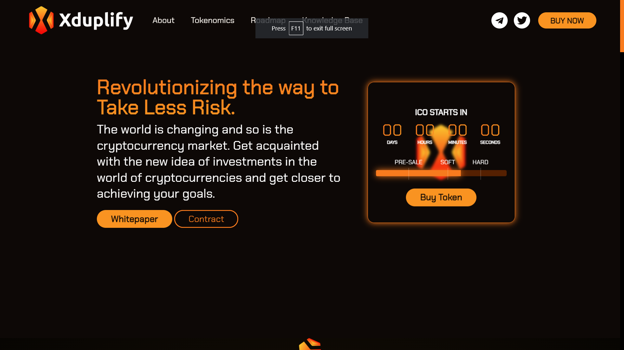

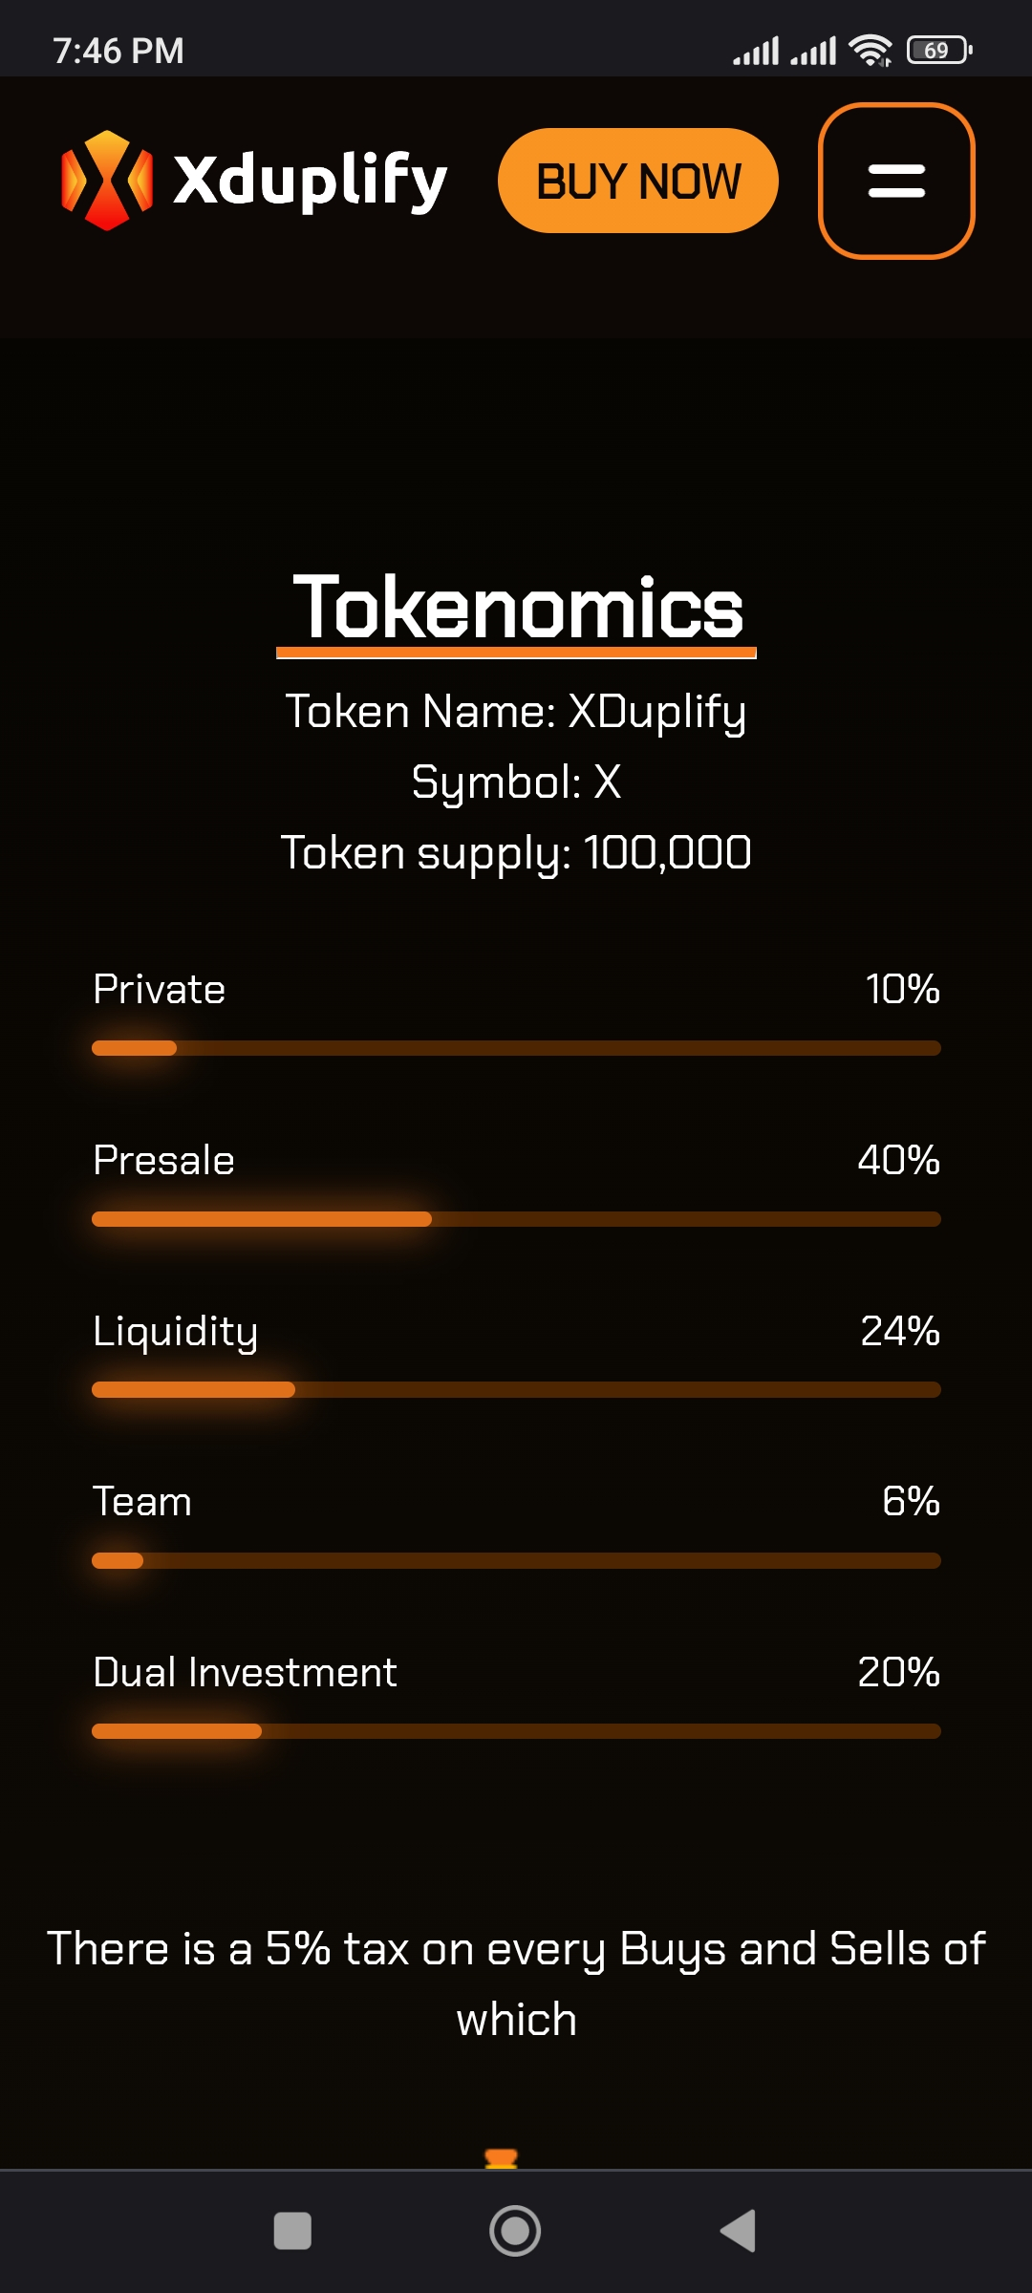
The future of Trading Today

Slide 21
Connect With Us
t.me/Xduplify
twitter.com/xduplify

